Slide 1
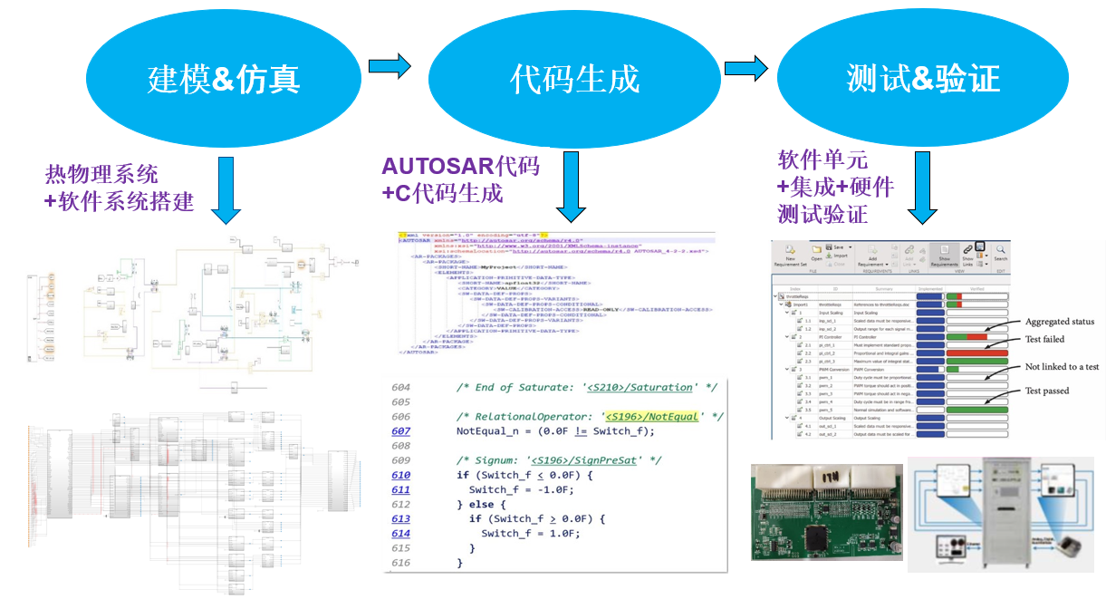
MBD Empowers the Vehicle Thermal Management
System with Control Algorithm Design and Software Implementation
Challenge
Increasingly complex functions and continuously rising energy-saving requirements have brought new challenges to the development of vehicle thermal management systems. The rapid growth of new energy vehicles is accelerating the iteration of thermal management control software.
Solution
Based on the Simulink platform, build thermal physical systems and control algorithms to simulate and validate the system solution as early as possible, and use Embedded Coder to automatically generate code from the control algorithm model.
Results
  Simulation accelerates complex system analysis and control algorithm development.
  Simulink graphical model development facilitates collaborative design among multiple people.
Model-Based Design of vehicle thermal management control software.
“For the development of vehicle thermal management systems, we adhere to the philosophy of ‘ensuring comfort while keeping the compressor operating within the COP range to achieve energy savings,’ to better serve our customers. MATLAB and Simulink simulation tools help us understand the physical behavior of the thermal management system and the effectiveness of control strategies, as well as explore new optimized control schemes. This enables us to rapidly iterate design parameters and explore the design space.”
— Dong Minghong, Chongqing Chaoli Electric Co., Ltd.
>> Link to customer speech at MATLAB EXPO China (in Chinese)

